Slide 1



BAN 612- Data Analytics
Group Presentation by:
Abhisha Burande (rq5588)
Anshika Sharma (fn5583)
Gyati Mittal (ji5288)
Maitreyee Das (xf7587)
Priyanka Kushwaha (dv7467)
Rajamani Chidambaram(vt5462)
Swati Hardasani(qd6852)

Slide 2
Real Estate Analysis
San Francisco Bay Area

Slide 3
What we did?
Collecting Data
Scraping Data
Feature Engineering
Data Analysis
Conclusion
Data Cleaning

Slide 4
Collecting Data
Source
RedFin.com
Automation Process
Chrome extension created using JavaScript
Automatically downloads html pages
Storage
HTML pages of houses listed in redfin are stored in local directory

Slide 5
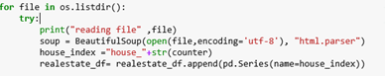
Scraping Data
Libraries Used:
Beautiful Soup
RE
Data Extraction:
Nested find
Soup’s find all
RE Search

Slide 6
Scraping Data
Libraries Used:
Beautiful Soup
RE
Data Extraction:
Nested find
Soup’s find all
RE Search

Slide 7
Scraping Data
Libraries Used:
Beautiful Soup
RE
Data Extraction:
Nested find
Soup’s find all
RE Search

Slide 8
Scraping Data
Libraries Used:
Beautiful Soup
RE
Data Extraction:
Nested find
Soup’s find all
RE Search

Slide 9
Features
MS rating
Middle School
High School
ES rating
HS rating
Elementary School
Price
Last sold price
Redfin Estimate
State
Property
Type
Bikeable
score
Address
Heating
Cooling
Year Renovated
City
Walkable score
Transitscore
Year Built
State
Lot acres
Baths
Garage
Zip code
Living Sq. Ft
Beds
HOA/Month
Parking

Slide 10
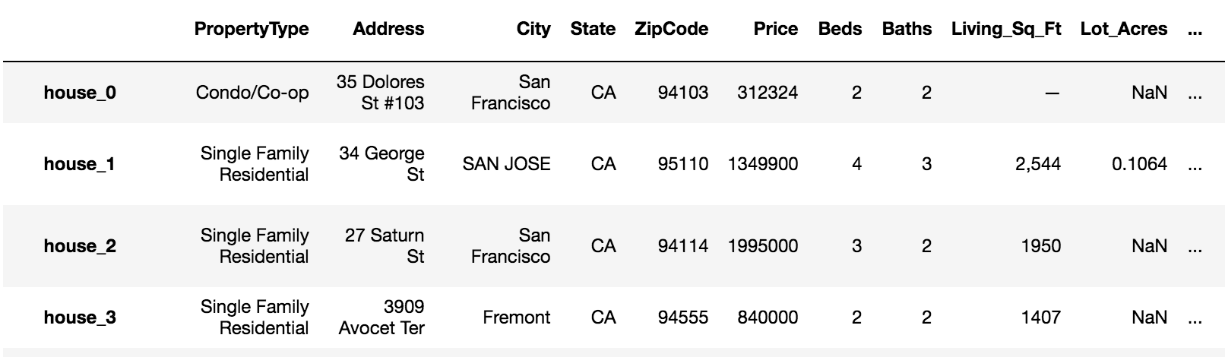
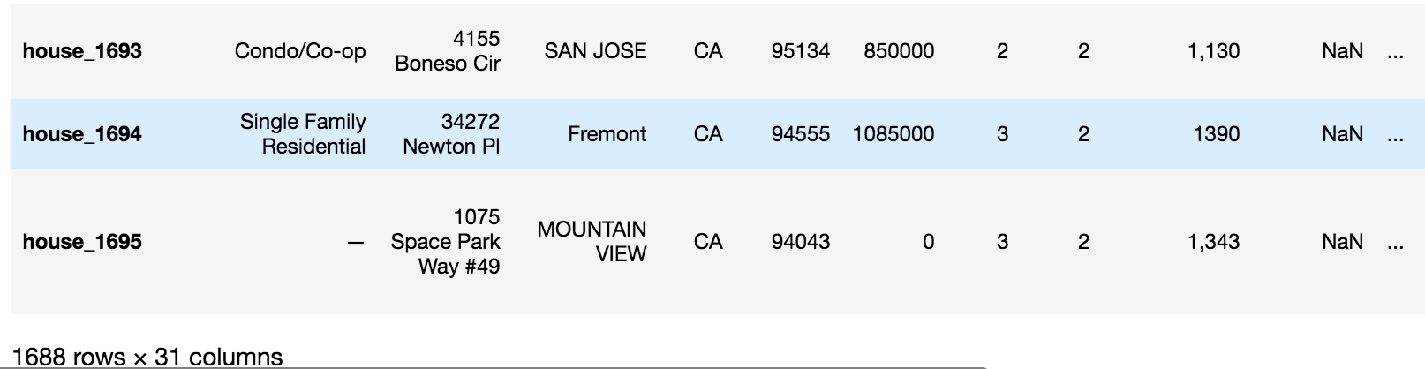
Snapshot of DataFrame

Slide 11

Data Cleaning
Duplicate records are removed.
Records with Null Address values are Dropped from DataFrame.
The name of the cities are in mixed case. So All city name is converted into lower Case.
Price Information(listing price, Redfin Estimate, Sold Price) are in string format with $ sign and comma. The $ sign and comma is removed from price info and is converted to numeric.
The zip code with 9 digit and with “hyphen” is converted to 5.
E:g 94087-8765 -→94087
Missing Data in Numeric Field is replaced with zero.

Slide 12


Data Analysis and Visualization
After Primary Cleaning Process Data Frame is saved in CSV Format.
All Imported the Csv File for Further Analysis of Research question And Visualization.
Library used :
Matplotlib
Seaborn
Sklearn
squarify
wordcloud

Slide 13



Slide 14
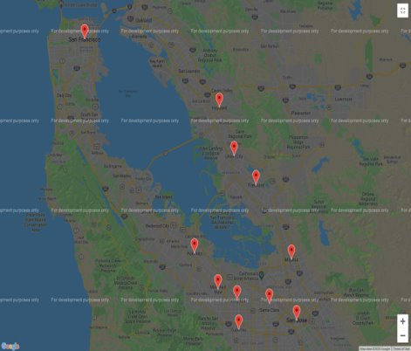


Statistical measures of House Price
FACTORS
Mean and Median House Prices
Group sales by Cities
Plot a google maps to show cities location along with mean and median of house prices
ANALYSIS
Displays the accurate city location for overview along with statistical measures.

Slide 15
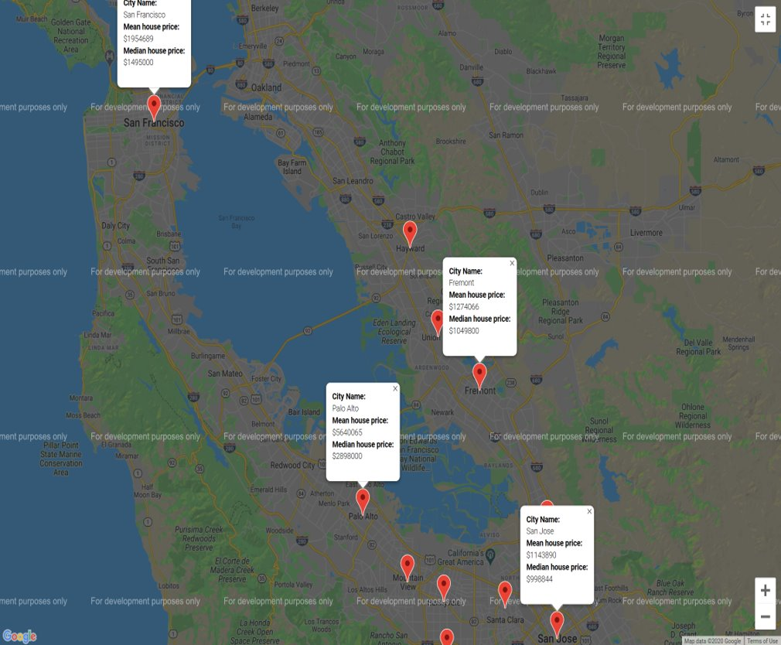
Statistical measures of House Price
FACTORS
Mean and Median House Prices
Group sales by Cities
Plot a google maps to show cities location along with mean and median of house prices
ANALYSIS
Displays the accurate city location for overview along with statistical measures.

Slide 16
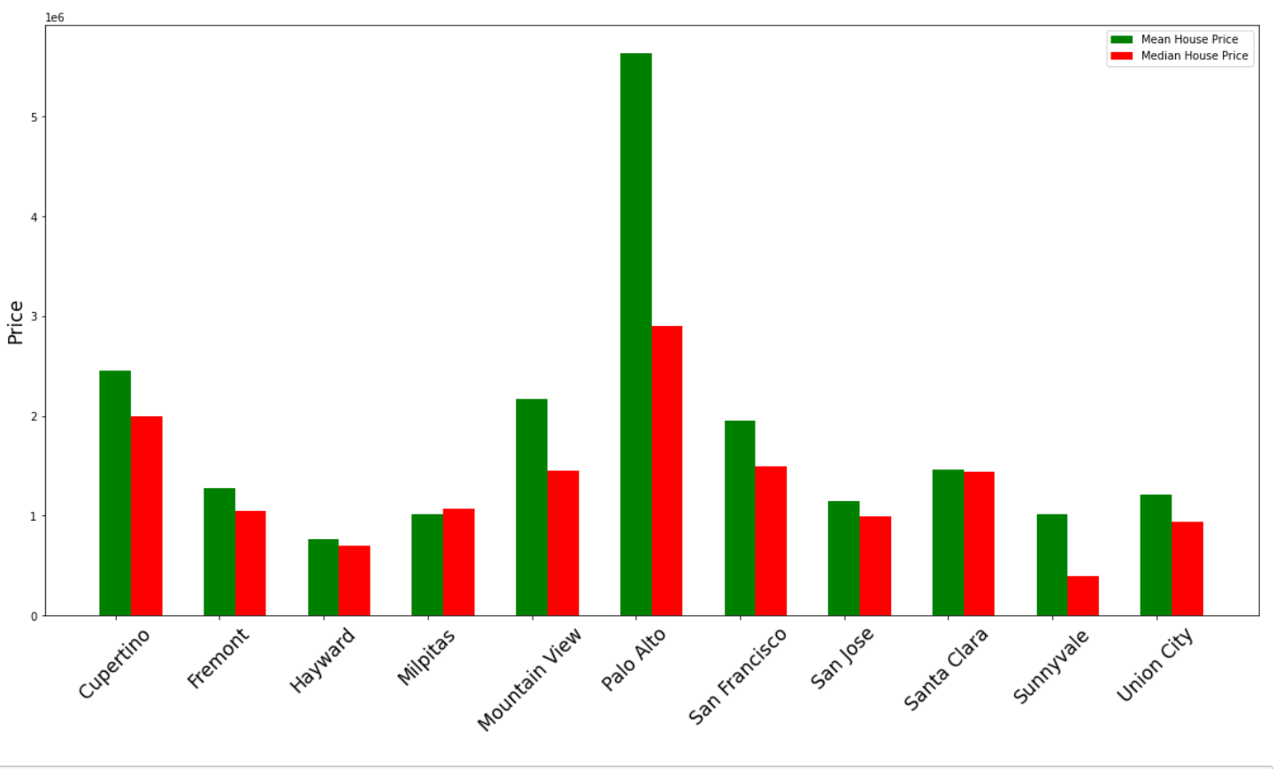
Comparison of mean and Median House prices
FACTORS
Mean and Median House Prices
Group by Cities
Plot a bar graph to show the mean and median house prices of cities
ANALYSIS
Highest mean and median price - Palo Alto (due to luxury houses)
Lowest mean price- Hayward
Lowest median house prices- Sunnyvale (due to mobile houses)

Slide 17
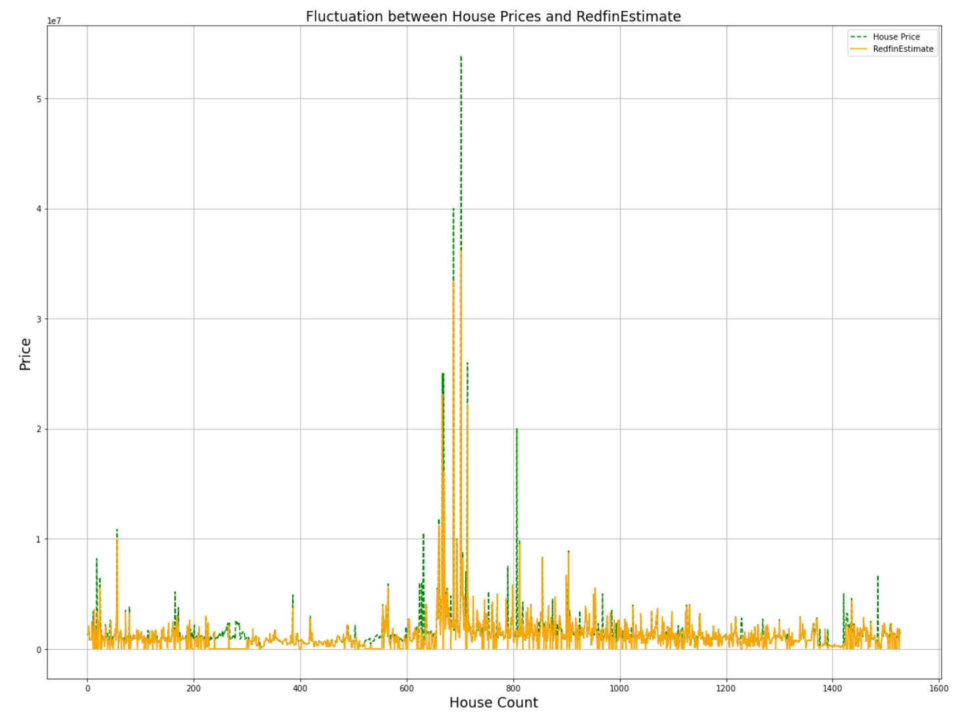
Fluctuation of actual house prices and RedfinEstimate
FACTORS
Actual House Price and RedfinEstimate
Group by Cities
Plot a line graph to show the fluctuation between Actual price and RedfinEstimate.
ANALYSIS
In majority of the cases, RedfinEstimate is greater than the actual house price

Slide 18
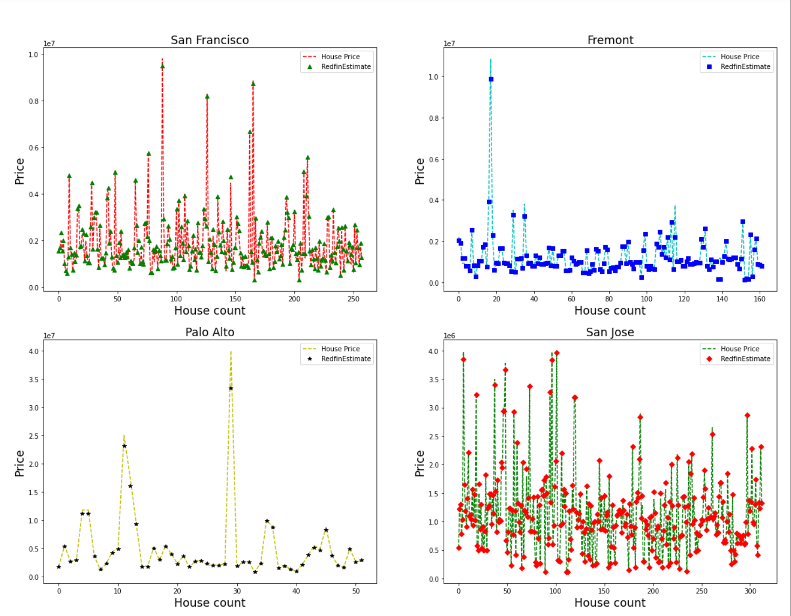
Fluctuation of actual house prices and RedfinEstimate
FACTORS
Actual House Price and RedfinEstimate in Bay area
Plot a line graph to show the fluctuation between Actual price and RedfinEstimate
ANALYSIS
Palo Alto was the exception due to luxury houses listed
In San Francisco, San Jose, Fremont: RedfinEstimate is higher than the actual house prices.

Slide 19
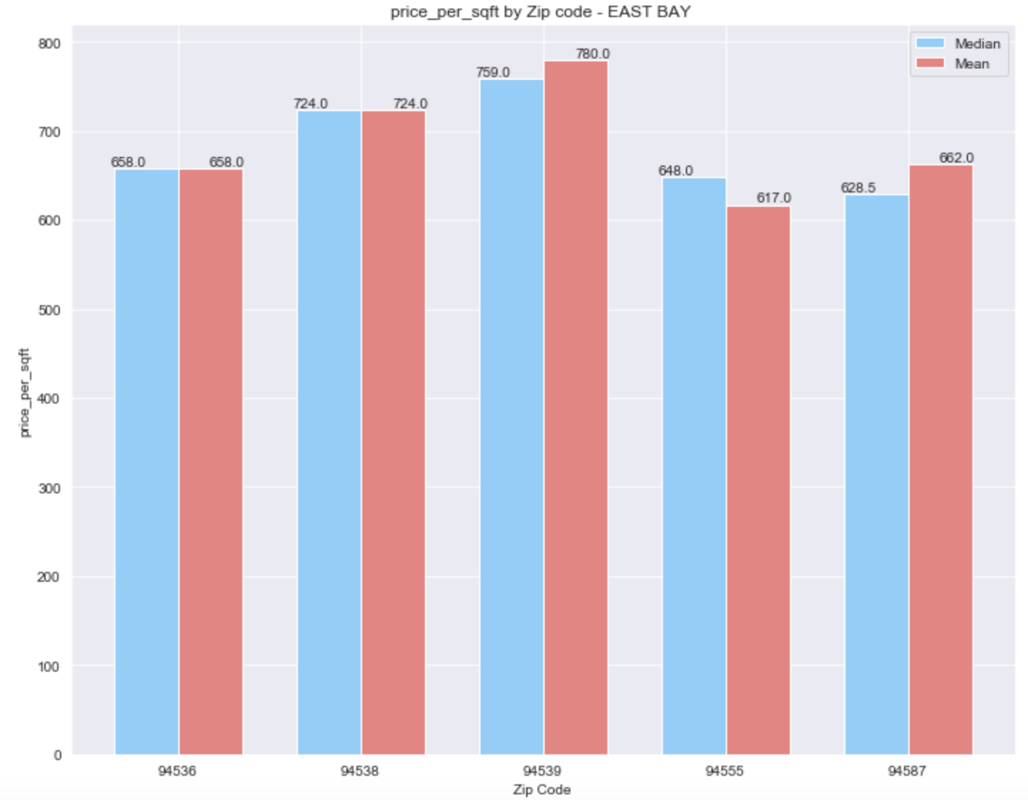
Price per Sq. Ft. by Zip Code – East Bay
FACTORS
Extracted Price of Fremont and Union City, divided it by Living Sq. Ft. for calculating Price per sq. ft.
Calculated mean and median price per sq. ft.
Group price per sq. ft by Zip Code
Plot grouped bar chart of mean and median price per sq. ft. by Zip Code.
ANALYSIS
Highest mean price per sq. ft. is $780 and median price is $759. Apart from various other factors affecting Price per sq. ft. of an area, having school ratings of 9 in Zip Code 94539 might be one of the reasons for high price.
Same city can show varied trend in price per sq. ft. as several reasons affect prices of home.
Screen Shot 2020-03-12 at 11.24.32 PM

Slide 20
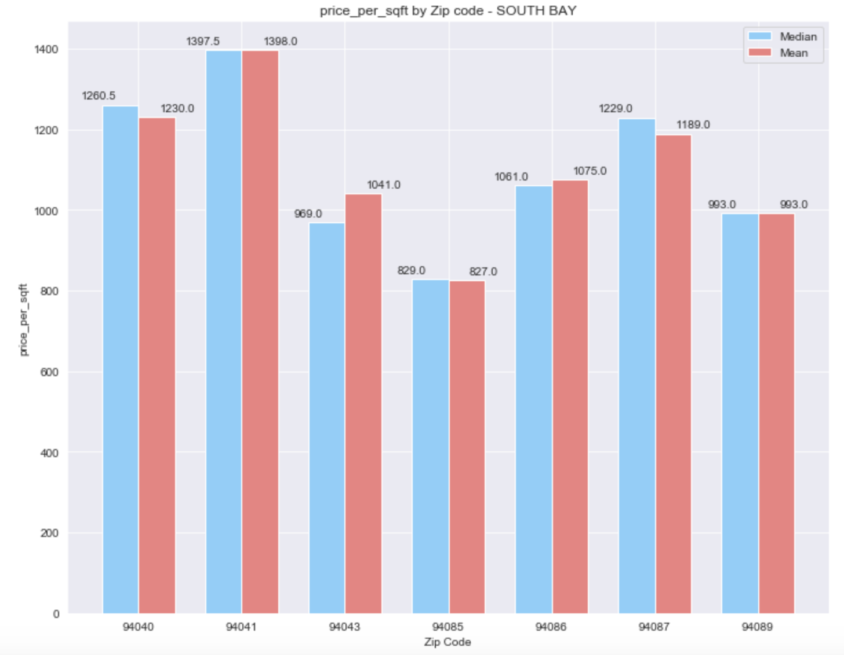
Price per Sq. Ft. by Zip Code – South Bay
FACTORS
Extracted Price of Sunnyvale and Mountain View, divided it by Living Sq. Ft. for calculating Price per sq. ft.
Calculated mean and median price per sq. ft.
Group price per sq. ft by Zip Code
Plot grouped bar chart of mean and median price per sq. ft. by Zip Code.
ANALYSIS
Highest mean and median price per sq. ft. is $1397.5. Corporate offices of Google, LinkedIn and Intuit are in neighboring areas and this might be the reason for higher prices.
Highest median price per sq. ft. in East Bay is 759 whereas in South Bay it is 1397.5. Lowest median price in East Bay is 617 and in South Bay it is 829. It can be concluded that South Bay has higher price sq. ft.

Slide 21
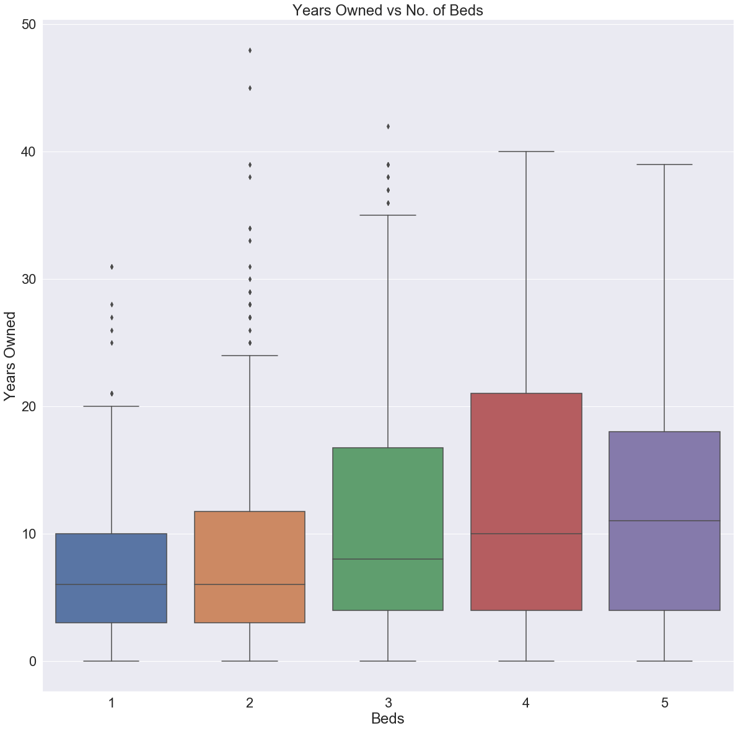
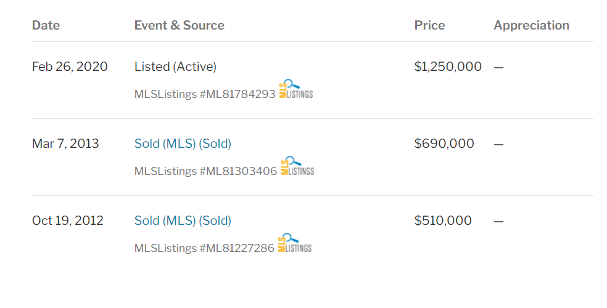

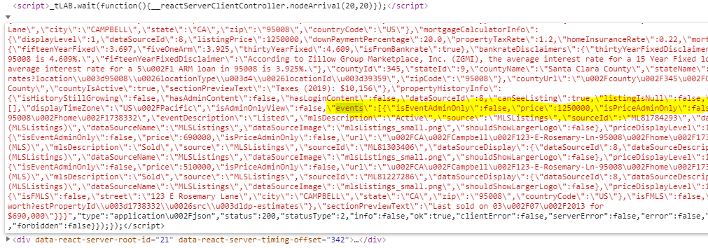
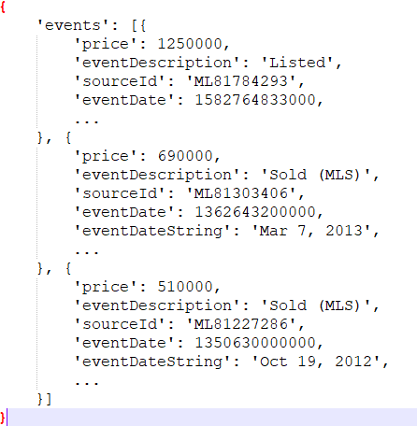
Age of Ownership by No. of Beds
FACTORS
Scrape Sale History from HTML/JSON file
Compute Years Owned by calculating period between consecutive sales
Group sales by No. of Beds
Plot a boxplot to show variation of Years Owned
ANALYSIS
As the No. of Beds increases median age of ownership also increases.
Typically 1 Bed and 2 Bed home-owners stay in the same property for 6 years
Conclusion: The bigger the home, the longer the owner tends to live in it.

Slide 22
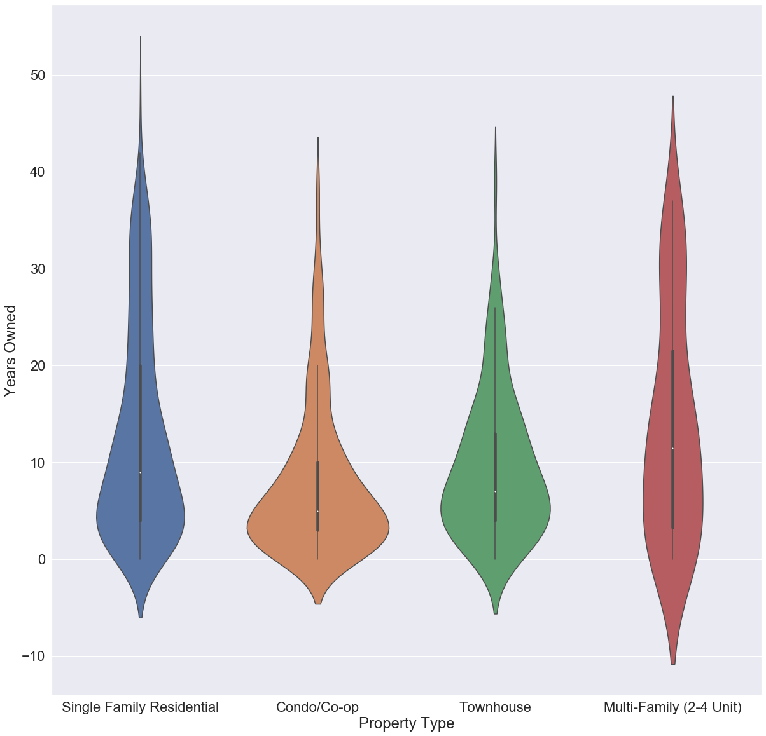
Age of Ownership by Property Type
FACTORS
Extract Years Owned by calculating period between consecutive sales
Group sales by Property Type
Plot a violin plot to show variation of Years Owned
ANALYSIS
Majority of the Condo/Co-op and Townhouse owners seem to move on after 6-7 years.
We see a larger spread in Years Owned for Single Family and Multi-Family units

Slide 23
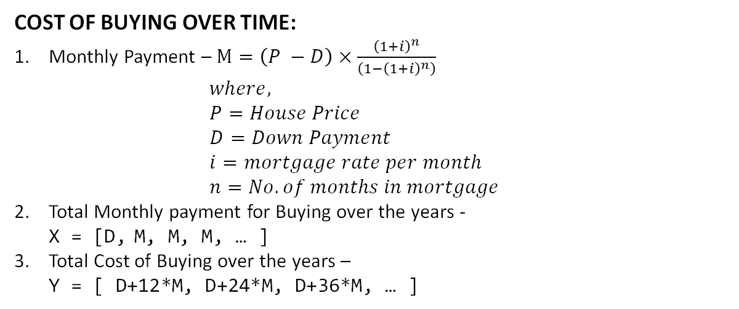
Renting Vs Buying
COST OF RENTING OVER TIME:
Rent Paid over the years - X = [rent, rent*(1+rentHike), rent*(1+rentHike)², ...] where, rent = Average annual rent (Scrape from bestplaces.net) rentHike = Rent Appreciation Rate ( = 3% )
Total Cost of Renting over the years - Y = [(X₀), (X₀+X₁), (X₀+X₁+X₂), … ]
COST OF BUYING OVER TIME:
Monthly Payment – $M=\left(P −D\right)×\frac{{\left(1+i\right)}^{n}}{\left(1−{\left(1+i\right)}^{n}\right)}$ $where,$ $P=House Price$ $D=Down Payment$ $i=mortgage rate per month$ $n=No. of months in mortgage$
Total Monthly payment for Buying over the years - X = [D, M, M, M, … ]
Total Cost of Buying over the years – Y = [ D+12*M, D+24*M, D+36*M, … ]
(Mean House Price)
( 20% of Price )
( = 3.5% APR)
(= 30 years = 360 months)

Slide 24
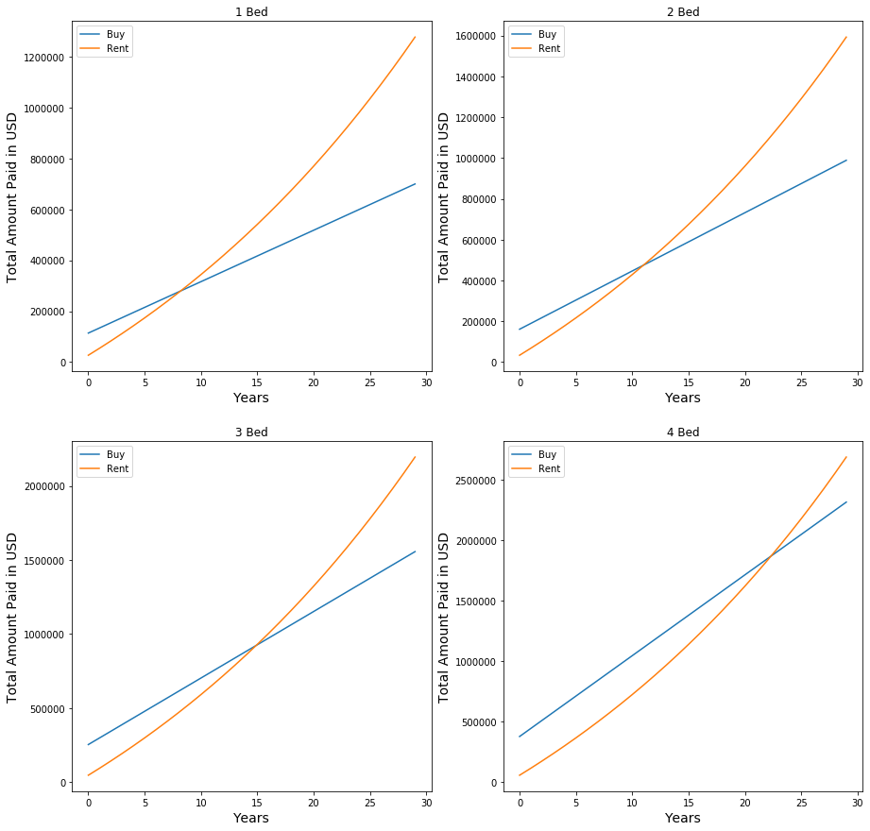
Renting Vs Buying (Fremont)
FACTORS
Extract average rent from bestplaces.net
Extract average price after grouping by City and no. of Beds
Plot renting cost and buying cost over time using methodology from previous slide
ANALYSIS
In Fremont, it is better to buy instead of renting if staying for more than 7 years in 1 Bed condo/house
If staying in a 4 Bed condo/house, you would need to stay for more than 22 years before it would be more profitable.

Slide 25
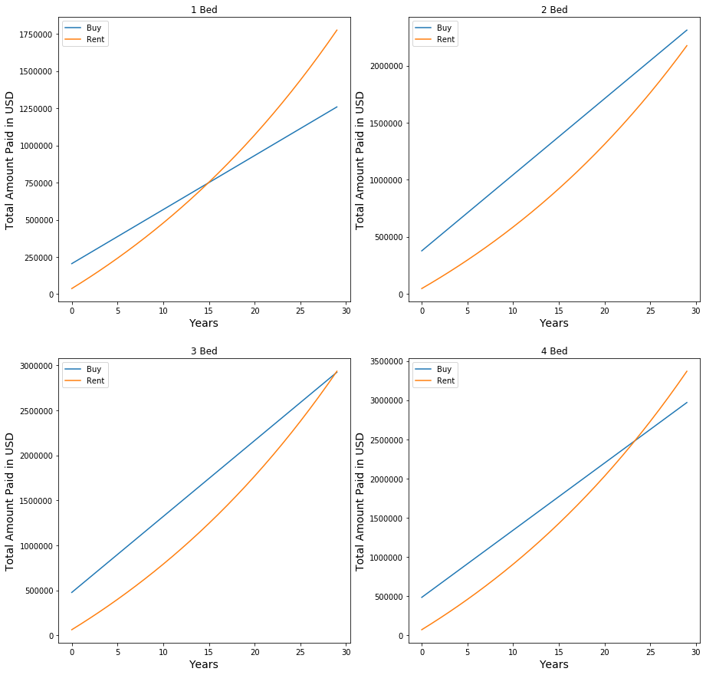
Renting Vs Buying (Cupertino)
FACTORS
Extract average rent from bestplaces.net
Extract average price after grouping by City and no. of Beds
Plot renting cost and buying cost over time using methodology from previous slide
ANALYSIS
In Cupertino for 2 Bed, even after staying for 30 years it would be more affordable to rent
Compared to Fremont, the break even point between renting and buying is higher for Cupertino
This is because the housing market is inflated in Cupertino

Slide 26

Case Study 1:
How Price varies with Walkable score ?
Through the data visualization techniques, we will verify this claim by Redfin:
https://www.redfin.com/blog/how-much-is-a-point-of-walk-score-worth

Slide 27
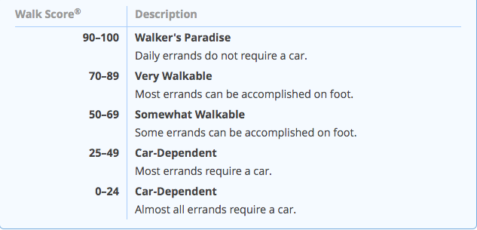
Walk Score Description

Slide 28
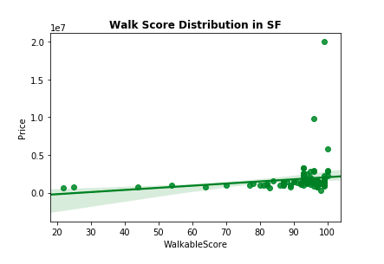
Walk Score Distribution
FACTORS
Plotting regplot to show that house price in San Francisco increases with the walk score.
Choosing San Francisco for this plot because it has lots of data points with walk score greater than 90
ANALYSIS
Regplot show that the walk score is highly skewed on the higher end when it comes to San Francisco.

Slide 29
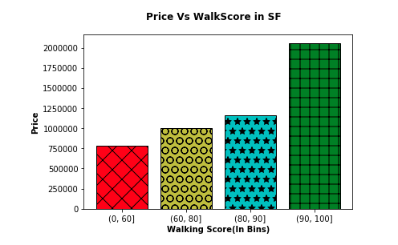
Price Versus Walk Score
FACTORS
Comparing price versus walk score data for SF to verify the claim by Redfin.
We group-by the data into the bins created above, then for aggregation we used the mean function.
ANALYSIS
We can observe that the redfin claim is absolutely true. Price does increase consistently with walk score.

Slide 30


Case Study 2:
How price varies with Garage/Parking value in metro cities (like SF) in comparison to smaller cities (like San Jose, Sunnyvale etc.)?
We will verify this claim made by Redfin through further visualization techniques:
https://www.redfin.com/blog/does-a-garage-add-value-to-a-home/

Slide 31
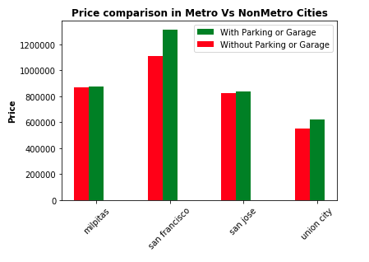
Price Versus Parking/Garage
FACTORS
Comparing price versus Parking/Garage data for SF to verify the claim by Redfin.
Constructing a side-by-side bar plot from the dictionary.
ANALYSIS
Through this adjoining graph, one can observe how much difference can parking add to the home price, particularly in big metros like SF, hence verifying redfin's claim.

Slide 32
Guess
Which is more accurate
Redfin Estimate or Zillow Estimate?
Notes:
Before my questions start guess which is more accurate

Slide 33
Problem
How to find the accuracy?
Redfin Estimate vs
Zestimate
380K
Redfin Estimate
450K
Zestimate
100K
750K
400K
Sold Price
now let’s do some maths =)
((380K – 400K) / 400K) * 100 = -5 %
((450K – 400K) / 400K) * 100 = 12.5 %
Then,
creating bins of 1% each
from -5% to +5% for histogram
Notes:
Now how to find the accuracy?
In case of this accuracy the closest you are the sold price
Consider the linear scale of

Slide 34
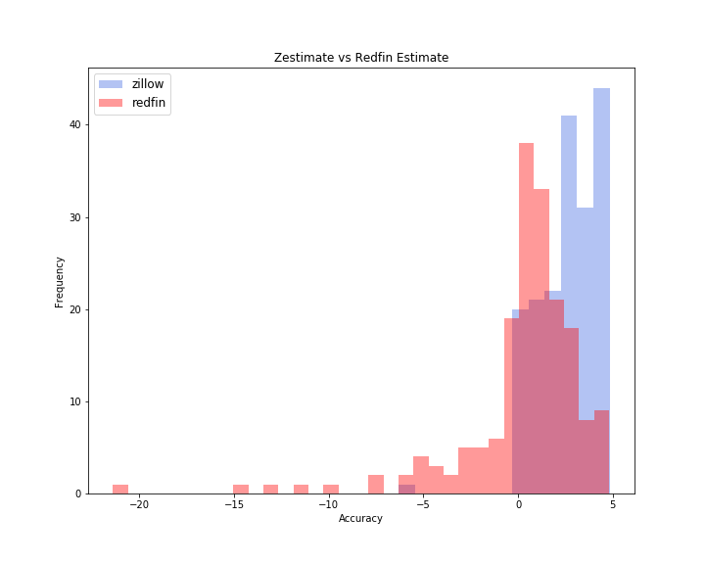
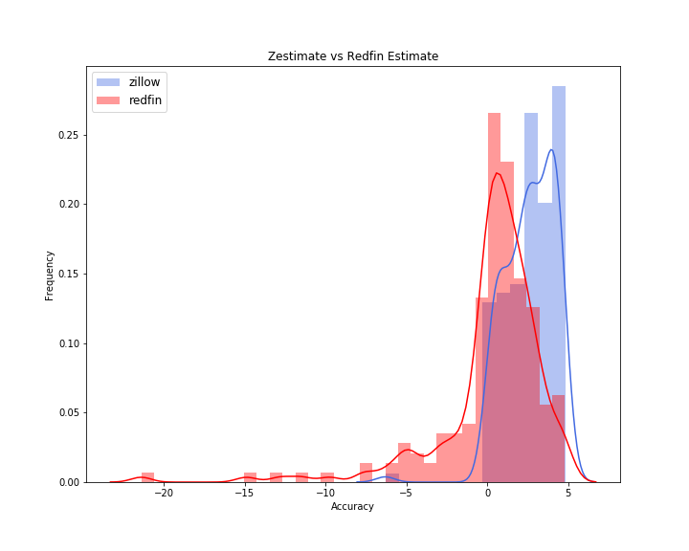
Redfin Estimate
vs
Zestimate
FACTORS
Extracted Zestimate for sold houses for the city in consideration.
Used NLP cosine algorithm to match the addresses from redfin and Zillow
Calculated the percentage change of Redfin Estimate and Zestimate from the sold price and plotted a histogram and kernel density estimate to show the density of data
ANALYSIS
Redfin Estimate is more accurate than Zestimate as the frequency of the values is closer to the sold price which is 0 on the scale.
Redfin Estimate presents a highly normalized curve whose peak is near closer to the sold price than Zestimate
Histogram
Histogram and Kernel Density Estimate

Slide 35
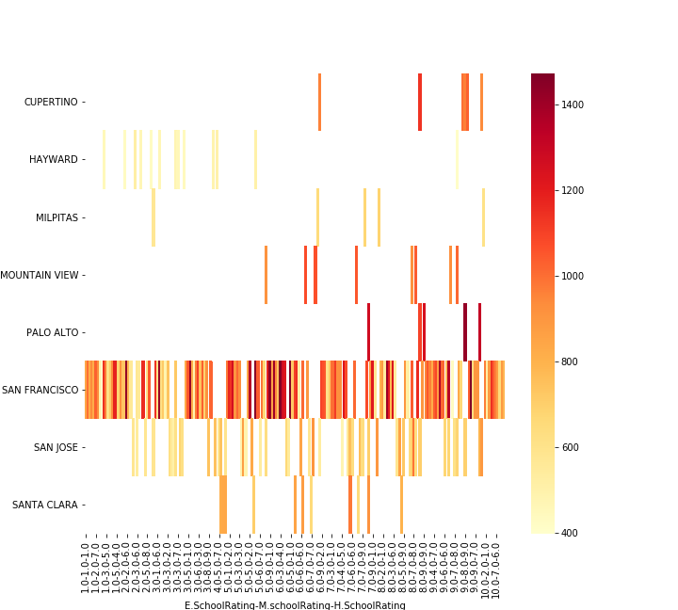
Relationship between School Rating and Price/Sqft
Aggregate
FACTORS
Scraped Elementary School Rating, Middle School Rating, High School Rating from Redfin
Calculated Price per Sqft by dividing the price and living sqft area
Group all the ratings by city.
To make a comparison plotted a heatmap to see the impact.
ANALYSIS
Cities where all the schools have a good rating prices of the houses are mostly high Ex: Cupertino, Palo Alto
Some cities are unaffected by the school rating. Ex: San Francisco

Slide 36
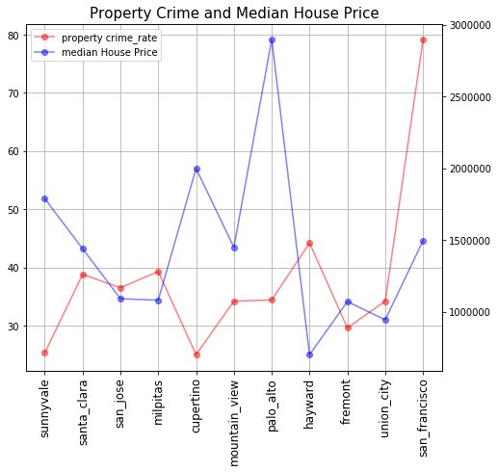
Relationship Between Property Crime Index and Median House Price
FACTORS
•Scraped property Crime index data of 11 cities from https://www.bestplaces.net/
•Median House Price of active houses on Redfin is calculated .
•To make a comparison Line Graph is plotted having x axis with city name and y axis carries two scales –one for median house price and the other one is for crime index.
ANALYSIS
As the crime Rate increases median house price is comparatively less
San Francisco is not impacted by this trend

Slide 37
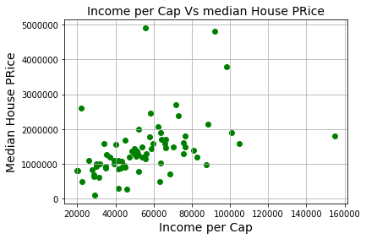
Relationship Between Per Capita Income and Median House Price
FACTORS
•Scrapped income per capita of 75 zip codes of 11 cities from https://www.bestplaces.net/
•Per capita income tells about the avg income of a person belong to that geographical area.
•Median House Price of active houses on Redfin is calculated for those 75-zip code of 11 cities.
•To make a comparison Scatter plot is created
having x axis with income per capita and y axis carries median house price scale
ANALYSIS
The zip codes with higher median income, the median price of the house is also more

Slide 38
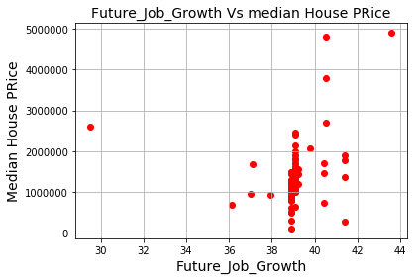
Relationship Between Future Job Growth Pct and Median House Price
FACTORS
future job growth rate info extracted from https://www.bestplaces.net/
The higher the number the better
Median House Price of active houses on Redfin is calculated
ANALYSIS
As the future job growth rate increases median house price is also comparatively increases
The job growth prediction of around 43% shows median house price of around 5M.

Slide 39
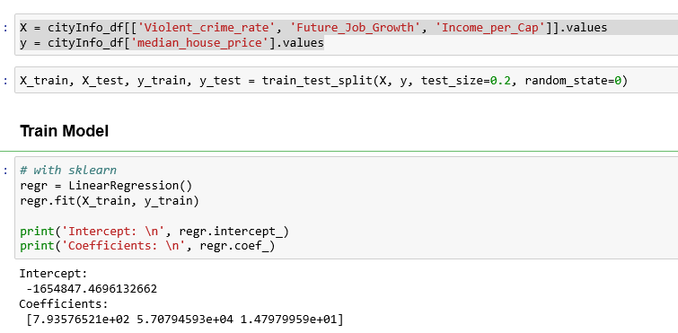
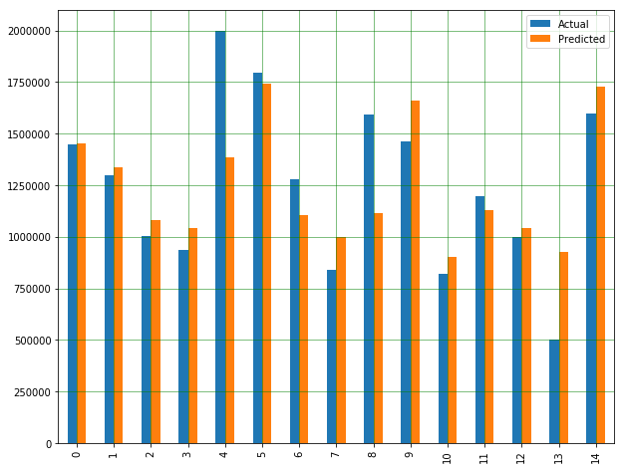
Multi Linear Regression Model
Data set is spitted with 80:20 ratio build and validate the Regression Model to see if there is any correlation among crime index,per capita income and future job growth pct with median house price
Root Mean Squared Error around: 250K
Interpretation
Need to have a huge amount of data to get the best possible prediction.
The features that has not used in the model like school rating, walking score may have more correlation to the values we were trying to predict.

Slide 40
Machine Learning Model For Predicting Prices
Training Data
Model
Predicted Prices
Input Data
Feature Selection
Data Cleaning
Test Data
Select the features that would be important for the model for predicting price
Depending on the Mean absolute error, the selected features are also changed
Cleaned missing data using multiple techniques like filling with mean, default value, slicing, or dropping rows
Also used Label Encoding for including string features in the model
Model is built using XGBoost and fit with the training data
n estimators of 725 and learning rate of 0.05 was used
Predict function is used for predicting prices
Optimized model to improve the Mean Absolute Error
Predicted prices are mapped with existing data and compared with the actual and Redfin estimated prices

Slide 41
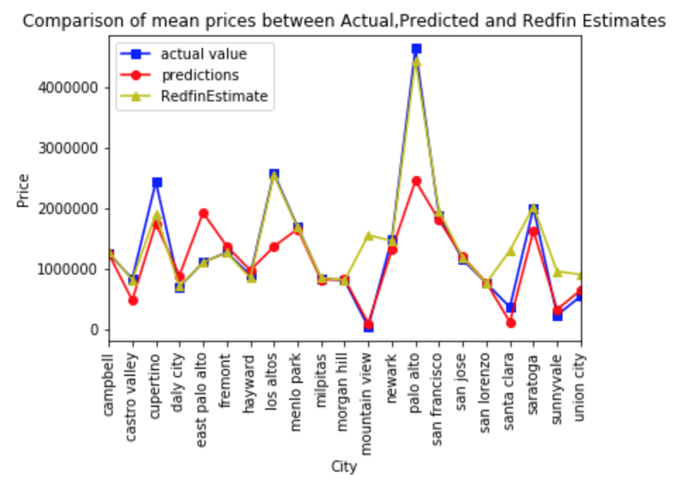
Comparison with Machine Learning Model’s Prices
FACTORS
Split data set into test and training data sets (80:20)
Used XGBoost to develop the model
Compared the predicted prices for the test data set
ANALYSIS
The predicted price is similar to the Actual Price in many cities and similar to the Redfin Estimate in some cities
The predicted price is different from Actual and Redfin Estimate in East Palo Alto, Los Altos, Palo Alto and San Francisco
In San Francisco and Palo Alto, the higher actual price may be because of market demand /bidding wars and other reasons which could be further researched
Notes:
Asha

Slide 42
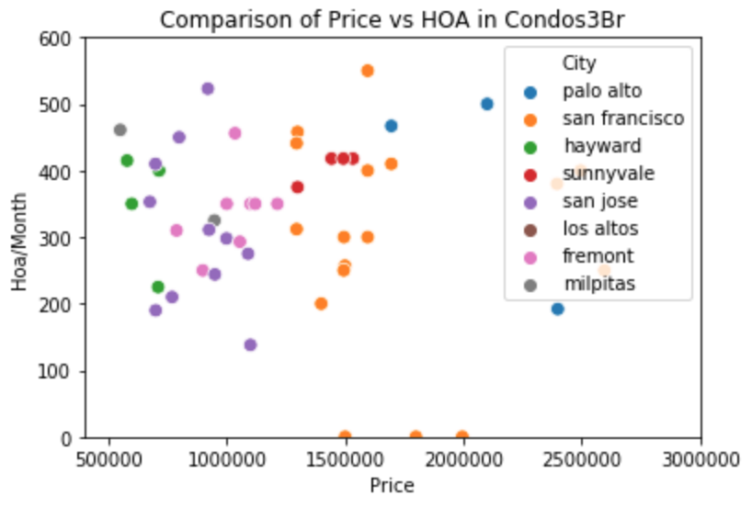
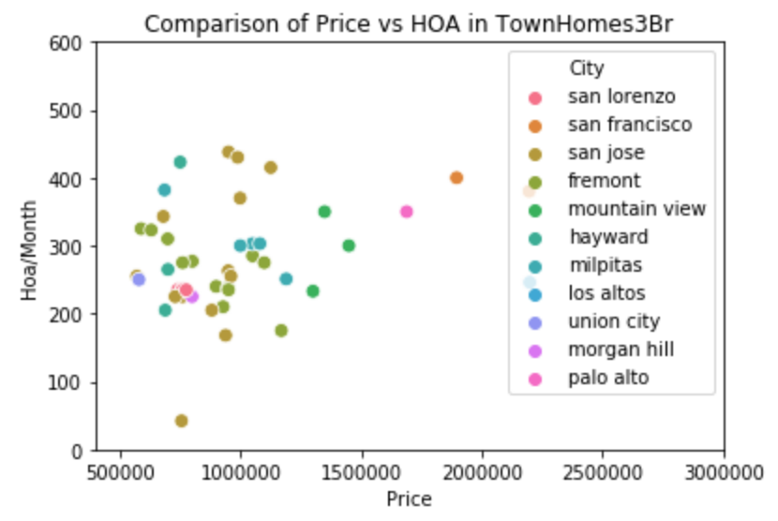
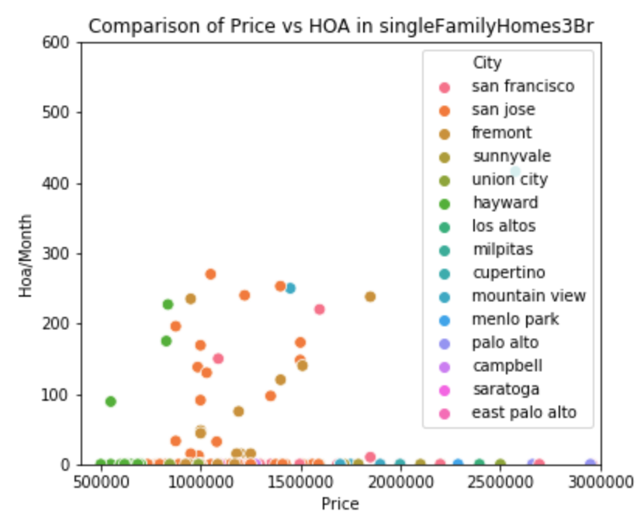
Comparison of price vs HOA in Condos , Single Family and Town Homes
FACTORS
Plotting price vs HOA by cities.
Compared 3 bedroom properties to get a view of similar properties across property types
ANALYSIS
Overall, the HOA for condos were higher (> $400)
For townhomes, the HOA’s are typically higher in San Jose.
Single Family Homes have no or very low HOA in most of the cities except for Hayward, San Francisco and San Jose.

Slide 43
Challenges:
The data for crime index, income per capita, future job growth, average rent detail are scrapped from another website using beautiful soup . The challenge was to merge data from two websites as per our research question.
Redfin was blocking the crawler.
Zillow didn't have MLS Listing for sold houses to match the data.
Jupyter keeps the objects alive even after they are not in use. Hence, caching in Jupyter causes issues sometimes.

Slide 44
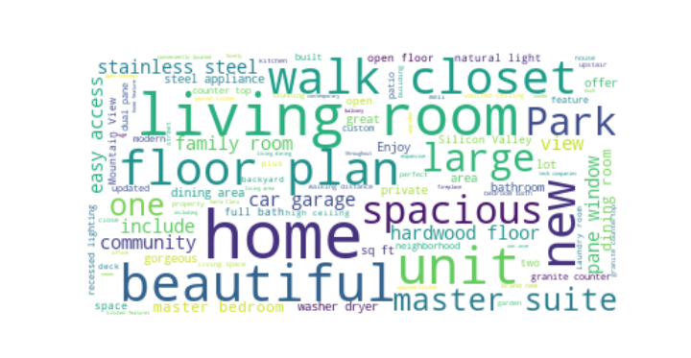
Thank You

